Slide 1
Calculator Project

Slide 2
Overview
Create a calculator app. It should provide the user with the ability to calculate basic arithmetic operations (add, subtract, multiply, divide). For simplicity, the calculator should operate using the tabulation approach. This means only one operation is handled at a time. Meaning the user will specify a number then an operation then another number and press the equals button. In the event the equals button is not pressed but another operation button is pressed, the calculator should calculate the preceding value display it on the screen then proceed to use the recently calculated value as the first value of the next operation. The calculator does NOT have to operate like a scientific calculator where all the options are specified then calculated but if you are feeling ambitious try to make it a scientific calculator. For an example of the tabulation, calculator interface take a look at this calculator. If the user types in an invalid mathematical expression the application should display an error message, and still be able to accept further input.
Aside from the operations specified above the calculator should have a button that clears the current operation and value. It should also have a button that opens a window that displays the past 100 instructions and answers. The user should be able to click one of these past answers and it should automatically be input at the first value of on the calculator main screen. The calculator should have a button to clear everything in the memory. This list of instructions should persist after the application is terminated. In other words, if you open the app and make a few calculations then close the app, then open the app again, we should be able to view the calculations from the previous session. No information is lost when we quit the app.

Slide 3
Extra Credit
Your calculator has the ability to perform the aforementioned operations as well a square root (2√x), n'th root (n√x), squaring (x^2), exponentiation (x^n), log and the natural log.
Your calculator operates as a scientific calculator. This means an entire arithmetic expression is specified by the user. Once the equals button is pressed, the entire expression is calculated as a whole. It should respect the rules of Order of Operations.

Slide 4
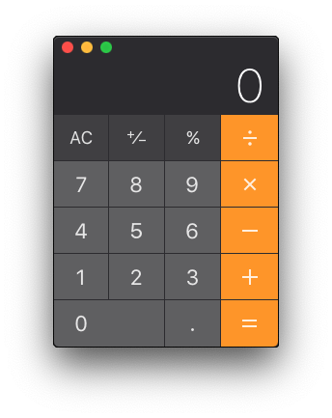
Example GUI
To the left is an example main window user interface of the calculator. Please use everything you have learned about Tkinter to achieve a suitable UI.
Do not forget you must also include a window the displays the past 100 instructions and answers presented in a list. Each line item in the list should contain the commands and their corresponding result. Example line item: 2 + 2 = 4

Slide 5
Saved History
Your calculator should save a file containing the history of the past instructions and their corresponding result. Feel free to save the information as a JSON list to a simple text file in the same directory as the app.
On subsequent uses of the calculator, it should read the data from the file to populate its memory.
The user should have the ability to clear this memory at anytime.

Slide 6
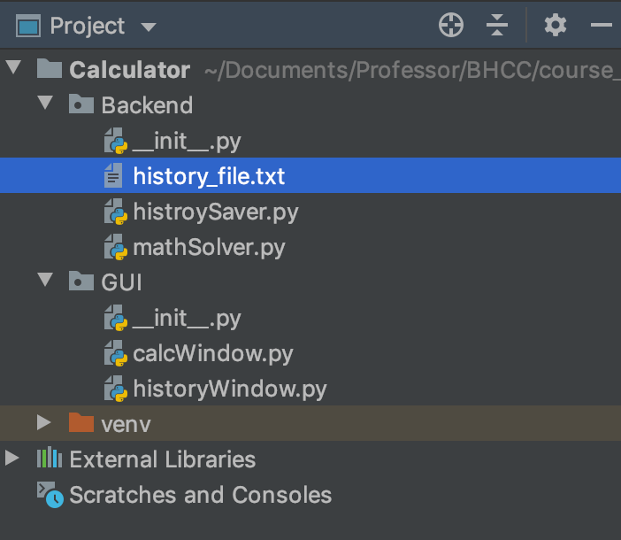
Submission
Submit a single zip file containing all your source code in the file structure you used to run your application. Additionally, submit a screen recording video of you using your calculator. The screen recording should properly demonstrate all of the features outlined in the next slide.
To the right is an example project structure. The project’s name is “Calculator”. You can see the project contains several packages. In this example you would compress the directory “Calculator” to a zip file and submit it.

Slide 7
Item | Description | Points
Necessary
Project Submission | The submission of source code that compiles. You submit all the necessary files in the specified format. | 20
Calculation GUI | The calculator has a GUI window that displays buttons to perform the specified arithmetic calculations. It also has a button that clears the current commands in the calculator and a button that takes the user to the history window. | 16
History GUI | The calculator has a GUI window that displays the past commands as outlined in the earlier slide, as well as a button to clear all entries. | 16
Calculation Functionality | When the user clicks the buttons and creates a valid mathematical expression, the application is able to produce a corresponding result. Any invalid mathematical expression inputted by the user should yield an error message and the app will continue to function. | 16
History Functionality | The user should be able to see at least 100 of their past arithmetic calculations and results. When the user clicks on a line item in the history window, they are taken to the calculation window of the app and the selected line item’s result is used as a value in the main calculation window of the app. When the user clears the memory all the information is removed. | 16
File IO | The data from previous uses of the application are saved to a file and when that application is opened again the user is able to view the prior calculations and results in the History GUI. | 16
Total Points |  | 100
Extra Credit
Extra Operations | The calculator has the ability to perform square root (2√x), n'th root (n√x), squaring (x^2), exponentiation (x^n), log, and the natural log. | 10
Scientific Calculator | The calculator meets the scientific calculator guidelines as outlined in the previous slide. | 10
Total Extra Credit Points |  | 20

Slide 8
Tips
Save a JSON list to a text file to store your history.
Use the numxpr package, to perform your calculations.
Start working on this as soon as possible.
When you ask questions, show examples of your code!
How do make screen recording? Mac and Window

